Slide 1
PREPROCESSING
Total 10000 images
Quantum Noise Reduction
2000 (Grade 0 ) Images
Dataset
Augmentation
2000 (Grade 1 ) Images
Histogram Equalization
2000 (Grade 2 ) Images
Unsharp Masking
2000 (Grade 3 ) Images
2000 (Grade 4 ) Images
Train 8000 images
Validation 2000 images

Slide 2
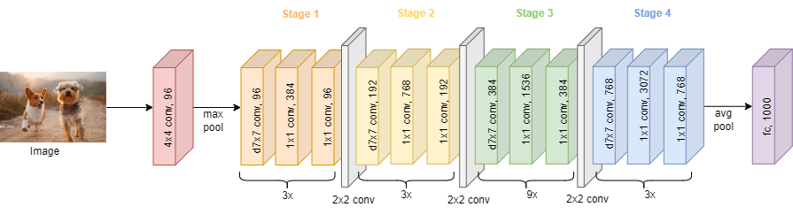
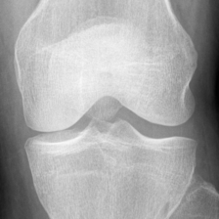
Knee X-Ray

Slide 3
Grad CAM
Feature Extraction
ResNet
Test Dataset
(To be given after
Training model)
Convolutional Block Attention Module(CBAM)
SVM
Machine learning
classifier
Output Prediction

Slide 4
Methodology:
Dataset
Total 10000 images
2000 (Grade 0 ) Images
Train 8000 images
Validation 2000 images
PREPROCESSING
2000 (Grade 1 ) Images
Quantum Noise Reduction
ResNet
Grad CAM
Augmentation
2000 (Grade 2 ) Images
Feature Extraction
Histogram Equalization
2000 (Grade 3 ) Images
Convolutional Block Attention Module(CBAM)
2000 (Grade 4 ) Images
Unsharp Masking
SVM
Machine learning
classifier
Test Dataset
(To be given after
Training model)
Output Prediction

Slide 5
Multi-Class Single Level
Test Dataset
CNN
GRADE 0
GRADE 1
GRADE 2
GRADE 3
GRADE 4

Slide 6
Multi-Class Multi Level
Test Dataset
ConvNeXt
NORMAL
ABNORMAL
ConvNeXt
GRADE 0
GRADE 1
GRADE 2
GRADE 3
GRADE 4

